Slide 1
Non-Equivalent Control Group Designs
Elizabeth Tipton
NSF Improving Education R&D Evaluations Workshop
2021

Slide 2
Quasi-experiments
Some researchers believe that it is easier to implement a quasi-experimental design than to conduct an experiment.
We believe that quasi-experimental designs are indeed easier to implement poorly, but much more difficult to implement well.

Slide 3
You should be worried
History
What if, in between when the intervention was implemented and the outcome observed, some *other intervention* also occurred.
Example: What if at the same time teachers implemented your new science program, they also adopted a new math program?
Maturation
What if the participants knowledge would have increased over time, even without your intervention?
Selection
What if the types of teachers that signed up for your program are different – more motivated, better teachers, more experienced – than those that didn’t?

Slide 4
You will likely need help
A strong design makes for an easy analysis:
In an experiment, the analyses are often quite straightforward – you are simply comparing average outcomes in the intervention group versus those in the comparison group.
A weaker design requires a more complex analysis:
In quasi-experiments, the analyses are much more complex, as as tests for model assumptions.
Doing these analyses well requires expertise – we recommend choosing a consultant or collaborator with these skills.

Slide 5
Selection Bias

Slide 6
Selection processes
Example: Smoking as an adult
More likely in low-SES population More likely to have adverse childhood experiences
People around them smoke Likely to have started smoking as children More likely to have mental health issues Weight control Parents smoked
Example: Kids play on a sports team
Parents played Have parents/ adults available to help Mid- to high- SES Are healthy Parents perceive it will positively affect outcomes
Available to them

Slide 7
Selection → Confounding
Confounding factors influence both the treatment assignment process (why some individuals are treated and others are not) and the outcome.
Confounding is the direct result of differential selection : i.e., wherein the treatment or intervention is not selected randomly but based on some background characteristics or perception of the effectiveness of the treatment.
Importantly, this selection process is unknown to the researcher.

Slide 8
Detecting confounding
Think about the selection process:
How did some units end up in treatment and others not? Examine data and identify baseline (pre-treatment) covariates Calculate balance statistics (compare means, SDs) between T/C on these covariates
Remember: In a randomized experiment, the distribution of these covariates would be the same in both T & C. This is your standard of comparison here
Scrutinize: are there other, unmeasured confounds not included here?

Slide 9
An intersection
Selection into Treatment
Outcome of interest
Strong ignorability set of variables

Slide 10
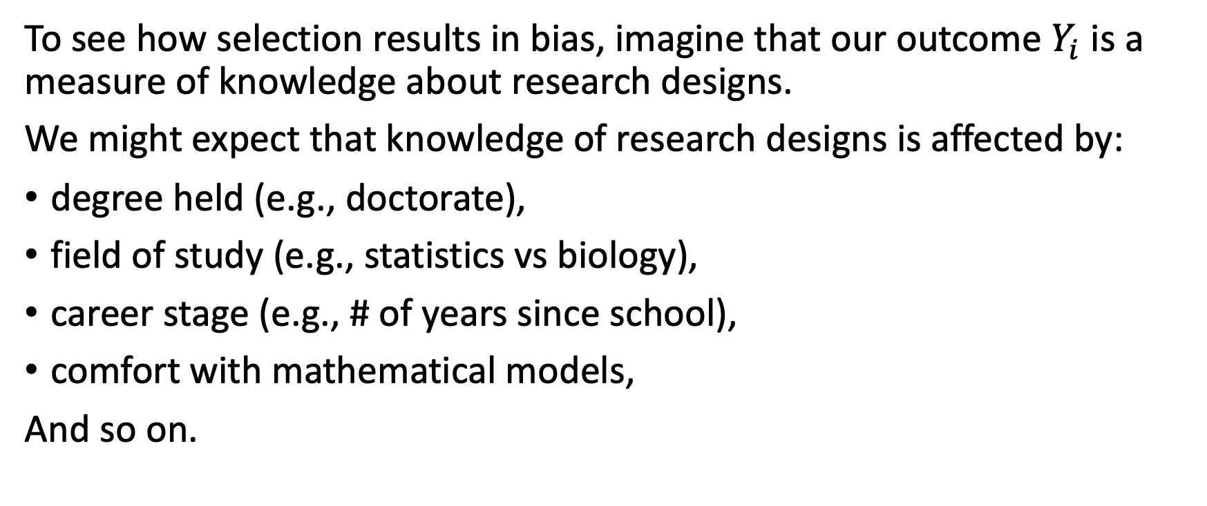
What bias?
To see how selection results in bias, imagine that our outcome $Y_{i}$ is a measure of knowledge about research designs.
We might expect that knowledge of research designs is affected by:
degree held (e.g., doctorate),
field of study (e.g., statistics vs biology),
career stage (e.g., # of years since school),
comfort with mathematical models,
And so on.

Slide 11
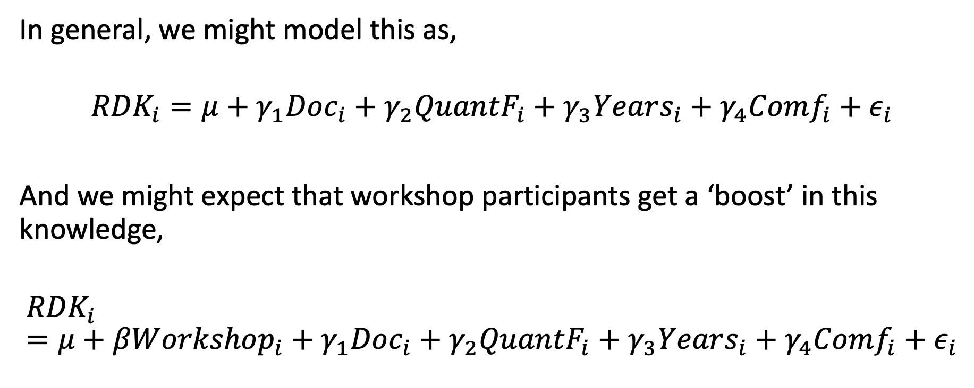
To be formal
In general, we might model this as,
$${RDK}_{i}=μ+γ_{1}Doc_{i}+γ_{2}QuantF_{i}+γ_{3}Years_{i}+γ_{4}Comf_{i}+ε_{i}$$
And we might expect that workshop participants get a ‘boost’ in this knowledge,
$${RDK}_{i}=μ+βWorkshop_{i}+γ_{1}Doc_{i}+γ_{2}QuantF_{i}+γ_{3}Years_{i}+γ_{4}Comf_{i}+ε_{i}$$

Slide 12
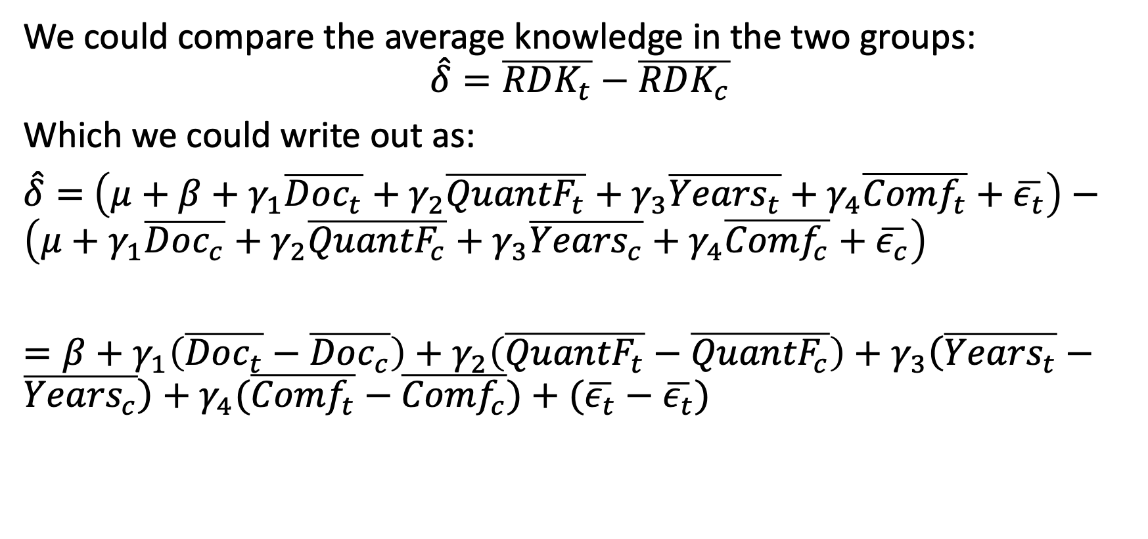
Comparing them
We could compare the average knowledge in the two groups:
$$\hat{δ}=\overline{RDK_{t}}−\overline{RDK_{c}}$$
Which we could write out as:
$\hat{δ}=$ $\left(μ+β+γ_{1}\overline{Doc_{t}}+γ_{2}\overline{{QuantF}_{t}}+γ_{3}\overline{{Years}_{t}}+γ_{4}\overline{{Comf}_{t}}+\overline{ε_{t}}\right)−\left(μ+γ_{1}\overline{Doc_{c}}+γ_{2}\overline{{QuantF}_{c}}+γ_{3}\overline{{Years}_{c}}+γ_{4}\overline{{Comf}_{c}}+\overline{ε_{c}}\right)$
$=β+$ $γ_{1}\left(\overline{Doc_{t}}−\overline{Doc_{c}}\right)+γ_{2}\left(\overline{{QuantF}_{t}}−\overline{{QuantF}_{c}}\right)+γ_{3}\left(\overline{{Years}_{t}}−\overline{{Years}_{c}}\right)+γ_{4}(\overline{{Comf}_{t}}−\overline{{Comf}_{c}})+(\overline{ε_{t}}−\overline{ε_{t}})$

Slide 13
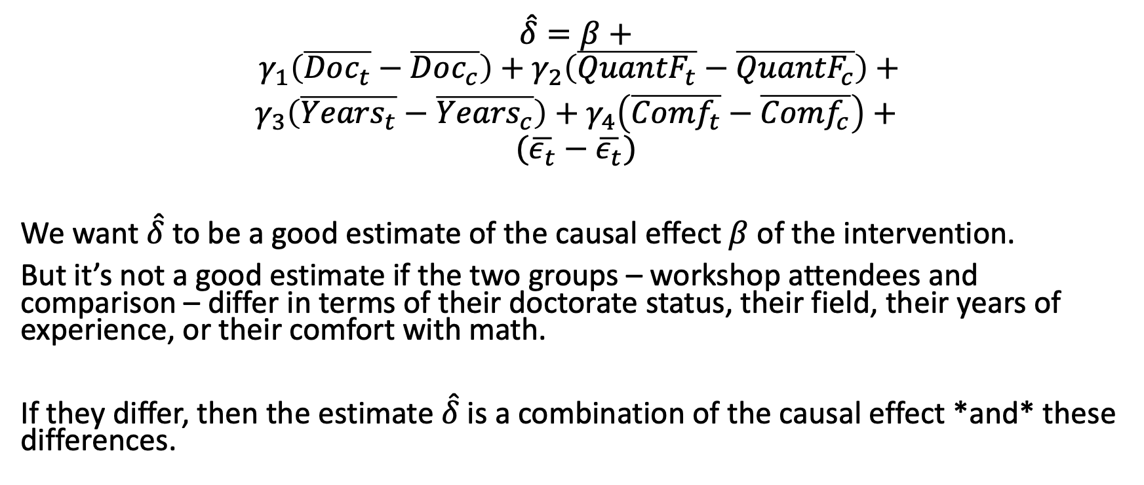
Uh oh
$\hat{δ}=β+$
$$γ_{1}\left(\overline{Doc_{t}}−\overline{Doc_{c}}\right)+γ_{2}\left(\overline{{QuantF}_{t}}−\overline{{QuantF}_{c}}\right)+$$
$γ_{3}\left(\overline{{Years}_{t}}−\overline{{Years}_{c}}\right)+γ_{4}\left(\overline{{Comf}_{t}}−\overline{{Comf}_{c}}\right)$ $+$
$$(\overline{ε_{t}}−\overline{ε_{t}})$$
We want $\hat{δ}$to be a good estimate of the causal effect $β$ of the intervention.
But it’s not a good estimate if the two groups – workshop attendees and comparison – differ in terms of their doctorate status, their field, their years of experience, or their comfort with math.
If they differ, then the estimate $\hat{δ}$is a combination of the causal effect *and* these differences.

Slide 14
But what about in RCTs?
Wouldn’t this same problem occur there? Couldn’t there be ‘unhappy’ randomizations that lead to some differences between the groups.
Yes, there could be some differences. But what you learned the last few days is:
If the differences are truly random, they are taken into account in the standard errors and don’t have to be adjusted for.
But if you do adjust for them, you can improve precision (and thus power).

Slide 15
Selection processes

Slide 16
What do we do about selection?
Soon, I will provide an overview of approaches, including:
Matching
Regression
Weighting
What all of these approaches have in common is that they require a set of confounders to be measured and specified and, ultimately, included in a model.
This is much harder than it sounds.

Slide 17
Confounders (again)
Selection into Intervention
Outcome of interest
Need to measure these variables

Slide 18
Begin by thinking about selection
Why did you (as researcher) approach these schools, teachers, or students to be part of the intervention? Were there certain criteria that they met in order for you to think they would be a good fit?
Why did the schools and/ or teachers taking part in the intervention group decide to join the study? Here, it is important to think both of the reasons they gave as well as how those that joined the study compare to those that did not.
Why did the parents and/ or students agreeing to be in the intervention agree to do so? Are they different than those that did not?

Slide 19
For example
In order to attend this workshop, you had to apply.
Then based upon this application, we selected some (and not others) to attend.
And then you had the choice to attend or to not attend.
That’s 3 selection processes at play here, all of which could result in differences between those of you with us and others in the field.

Slide 20
Importantly, keep in mind that selection is not always explicit and that a process that seems ‘random’ may still result in confounding.

Slide 21
Directed acyclic graphs (DAGs) can help
One strategy to identify confounders is to use a DAG (like an SEM or path model).
In a DAG, you specify:
Variables (observed or unobserved)
Arrows (directed) that indicate the direction of dependency

Slide 22
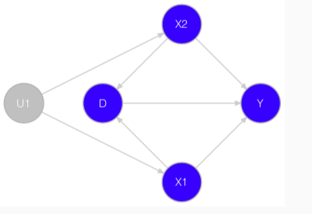
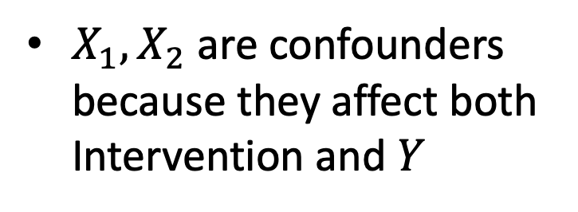
Interpreting DAGs
Intervention
$X_{1},X_{2}$ are confounders because they affect both Intervention and $Y$
Absence of a directed edge is an assertion of no dependency, and so typically requires justification/backing in theory.
Once specified, DAGs can be used to identify conditional independencies among variables, and thus determine which covariates to use for conditioning.

Slide 23
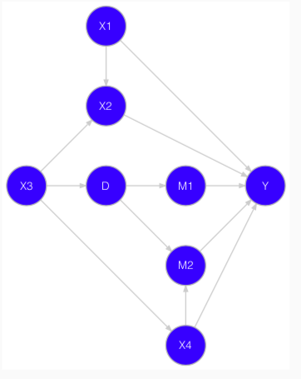
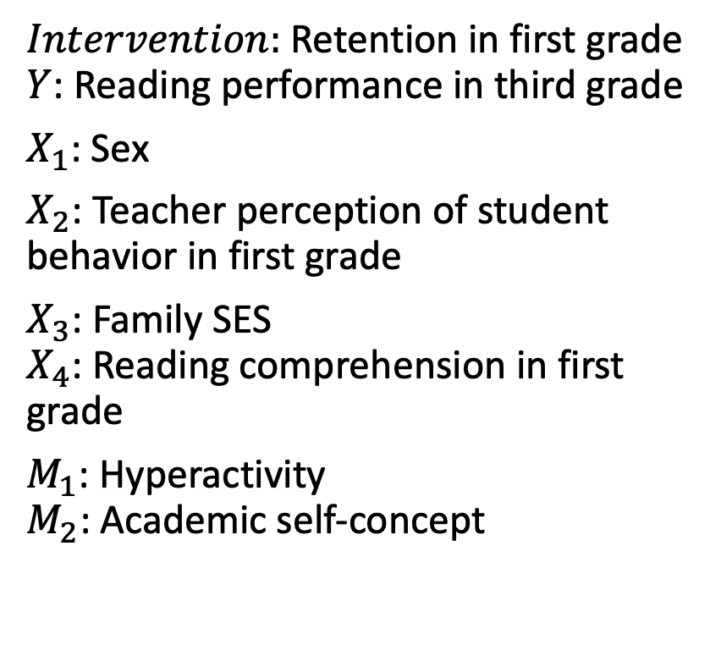
An example
$Intervention:$Retention in first grade $Y$: Reading performance in third grade
$X_{1}$: Sex
$X_{2}$: Teacher perception of student behavior in first grade
$X_{3}$: Family SES $X_{4}$: Reading comprehension in first grade
$M_{1}$: Hyperactivity $M_{2}$: Academic self-concept
Intervention

Slide 24
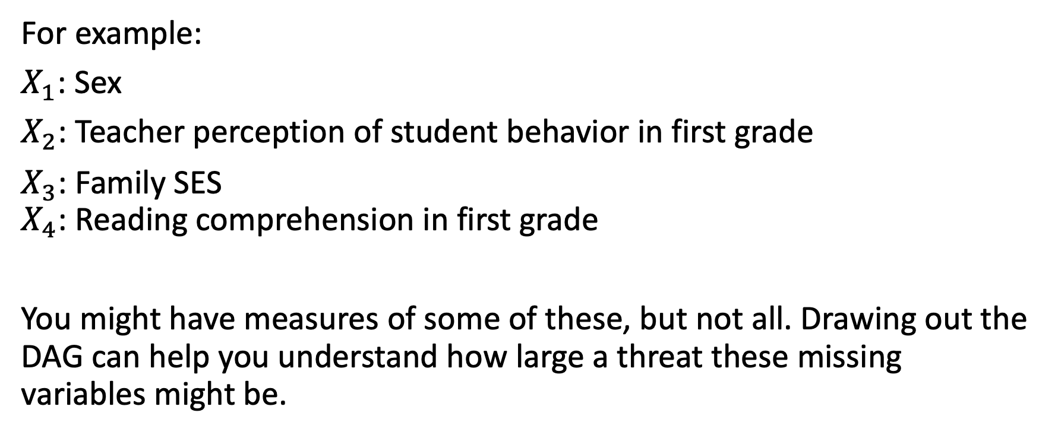
This helps you identify confounders
For example:
$X_{1}$: Sex
$X_{2}$: Teacher perception of student behavior in first grade
$X_{3}$: Family SES $X_{4}$: Reading comprehension in first grade
You might have measures of some of these, but not all. Drawing out the DAG can help you understand how large a threat these missing variables might be.

Slide 25
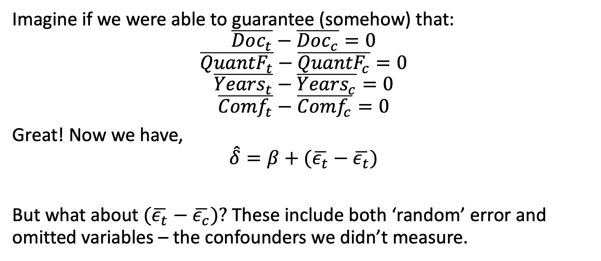
Omitted variables
Imagine if we were able to guarantee (somehow) that:
$$\overline{Doc_{t}}−\overline{Doc_{c}}=0$$
$$\overline{{QuantF}_{t}}−\overline{{QuantF}_{c}}=0$$
$$\overline{{Years}_{t}}−\overline{{Years}_{c}}=0$$
$$\overline{{Comf}_{t}}−\overline{{Comf}_{c}}=0$$
Great! Now we have,
$$\hat{δ}=β+(\overline{ε_{t}}−\overline{ε_{t}})$$
But what about $(\overline{ε_{t}}−$ $\overline{ε_{c}})?$ These include both ‘random’ error and omitted variables – the confounders we didn’t measure.

Slide 26
Omitted variable bias, always lurking
In the next part, we’ll go over several methods for adjusting for a set of specified confounders.
But properties of these estimators – and their ability to recover the causal effect of an intervention – depend upon having the right covariate set.
An ever-present threat is that of ‘omitted variable bias’ – confounders that exist in the real world, but that aren’t accounted for in the model.

Slide 27
Best practice
Given this concern, the best practice involves:
Reporting the DAG that led to the adjustment model used
Reporting the covariates (assumed confounders) that were adjusted for in your analyses
Being very clear that your goal is to estimate the causal effect, but that to do so you’ve had to use a model and assumptions

Slide 28
Worst practice
You may see all of this and feel like you want to throw up your hands and declare,
“But I’m not trying to estimate a causal effect. I know this effect is just associational! Of course, correlation is not causation!”
But this isn’t fair. What does this association even mean, if not causal? Why would you care about the differences between these groups otherwise?
Own that you care about the causality here. And own that this is difficult, that you’ve done the best you can, and that your results require some assumptions.

Slide 29
Matching Models

Slide 30
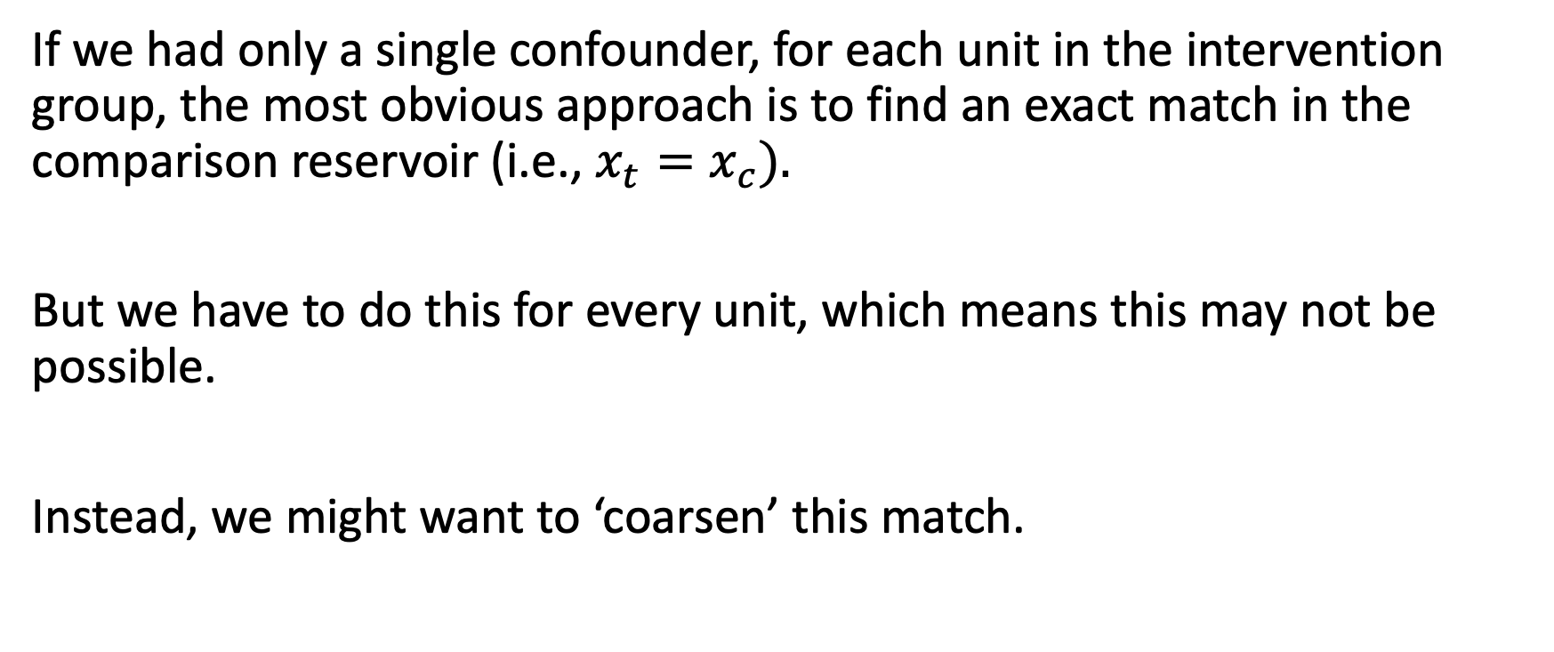
Single confounder (theoretical only)
If we had only a single confounder, for each unit in the intervention group, the most obvious approach is to find an exact match in the comparison reservoir (i.e., $x_{t}=x_{c}).$
But we have to do this for every unit, which means this may not be possible.
Instead, we might want to ‘coarsen’ this match.

Slide 31
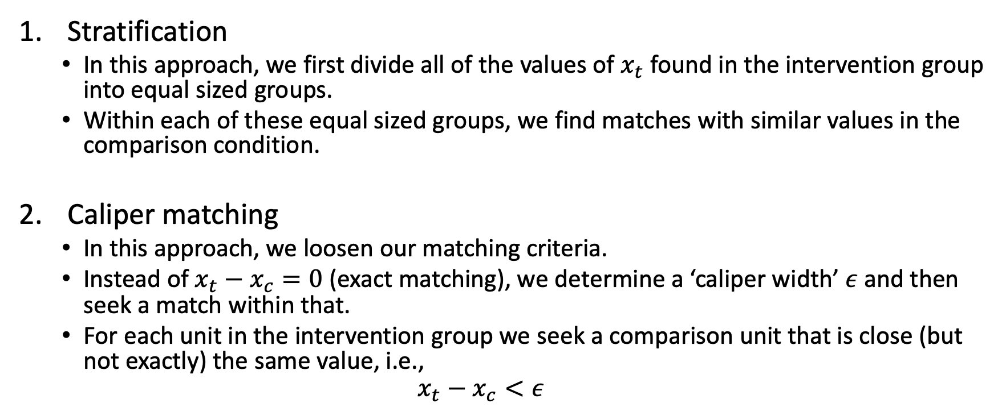
Coarsened matches
Stratification
In this approach, we first divide all of the values of $x_{t}$ found in the intervention group into equal sized groups.
Within each of these equal sized groups, we find matches with similar values in the comparison condition.
Caliper matching
In this approach, we loosen our matching criteria.
Instead of $x_{t}−x_{c}=0$ (exact matching), we determine a ‘caliper width’ $ε$ and then seek a match within that.
For each unit in the intervention group we seek a comparison unit that is close (but not exactly) the same value, i.e.,
$$x_{t}−x_{c}<ε$$

Slide 32
For example
In our workshop example, we might look for comparison researchers that:
Have the exact same degrees – e.g., doctorates (exact matching)
Have similar years of experience in the field (caliper matching), e.g., where we define similar as “+/- 2 years”

Slide 33
Multiple confounders
With one, or even two or three confounders, this isn’t that terrible.
But remember – those DAGs suggest that there are more. This makes matching *very* tricky.
One approach is to take this multivariate problem and turn it into a single variable, then use the same matching approaches as in the single confounder case.

Slide 34
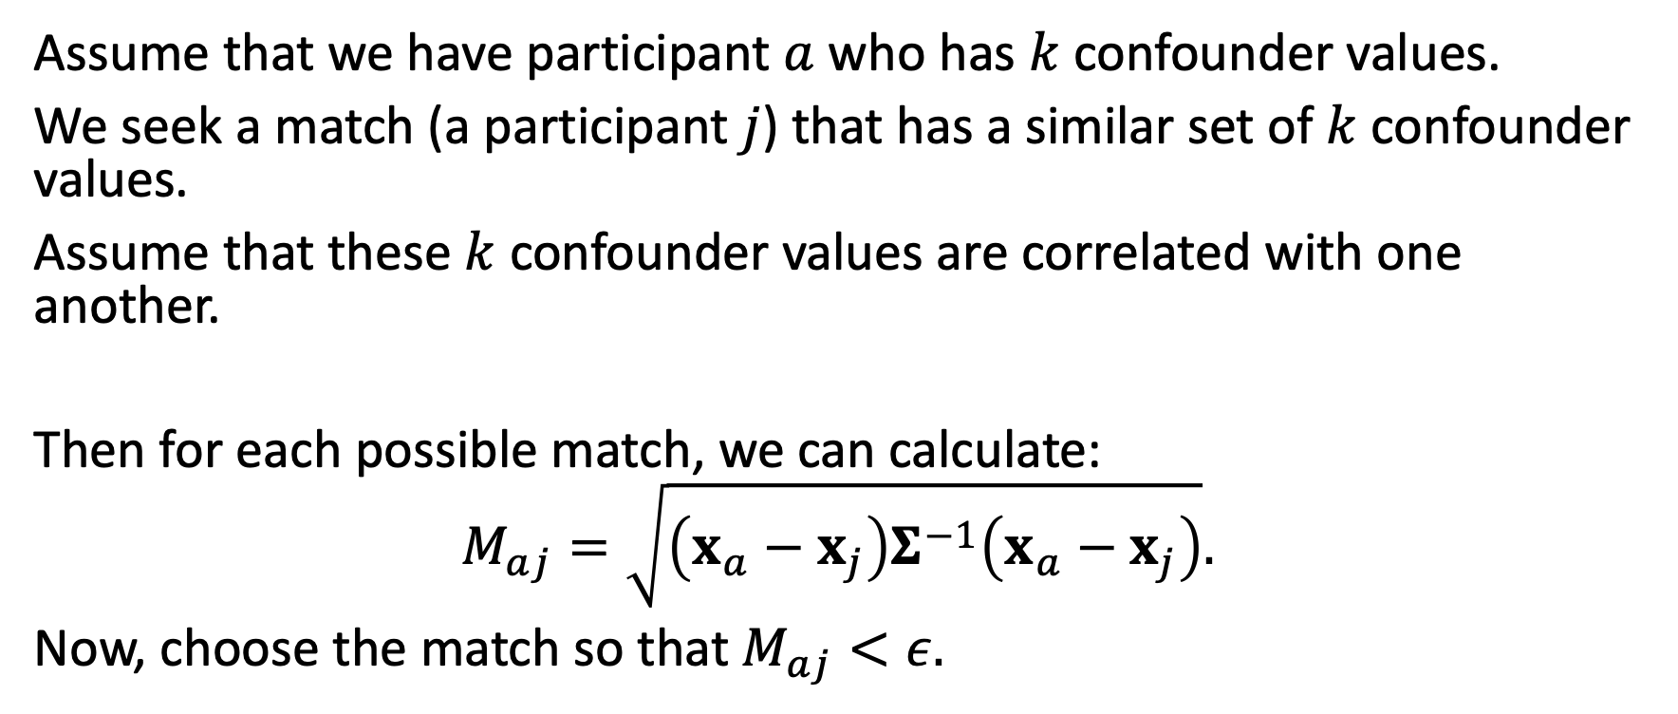
Mahalanobis distance
Assume that we have participant $a$ who has $k$ confounder values.
We seek a match (a participant $j$) that has a similar set of $k$ confounder values.
Assume that these $k$ confounder values are correlated with one another.
Then for each possible match, we can calculate:
$$M_{aj}=\sqrt{\left(x_{a}−x_{j}\right)Σ^{−1}\left(x_{a}−x_{j}\right)}.$$
Now, choose the match so that $M_{aj}<ε.$

Slide 35
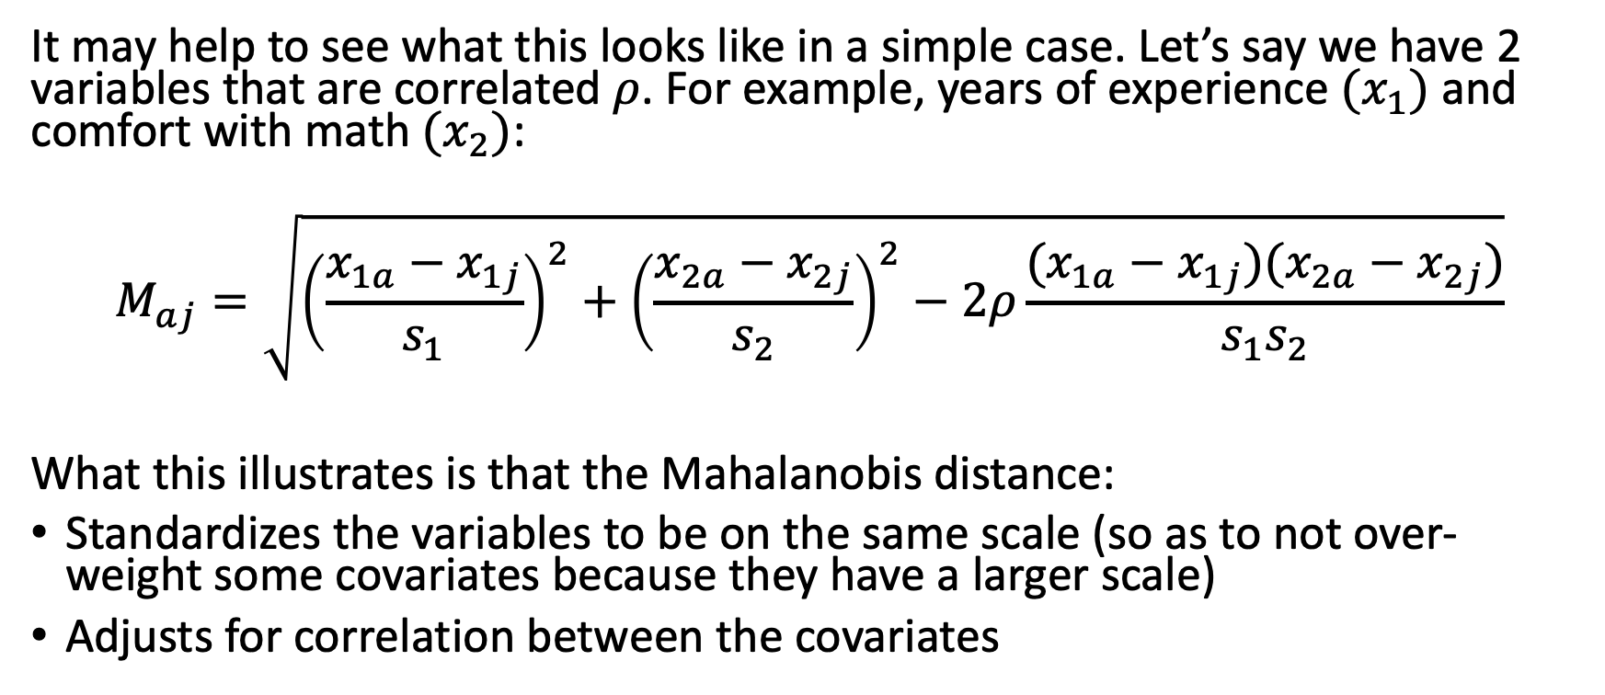
Vectors? Really?
It may help to see what this looks like in a simple case. Let’s say we have 2 variables that are correlated $ρ$. For example, years of experience $(x_{1})$ and comfort with math $(x_{2})$:
$$M_{aj}=\sqrt{{\left(\frac{x_{1a}−x_{1j}}{s_{1}}\right)}^{2}+{\left(\frac{x_{2a}−x_{2j}}{s_{2}}\right)}^{2}−2ρ\frac{(x_{1a}−x_{1j})(x_{2a}−x_{2j})}{s_{1}s_{2}}}$$
What this illustrates is that the Mahalanobis distance:
Standardizes the variables to be on the same scale (so as to not over-weight some covariates because they have a larger scale)
Adjusts for correlation between the covariates

Slide 36
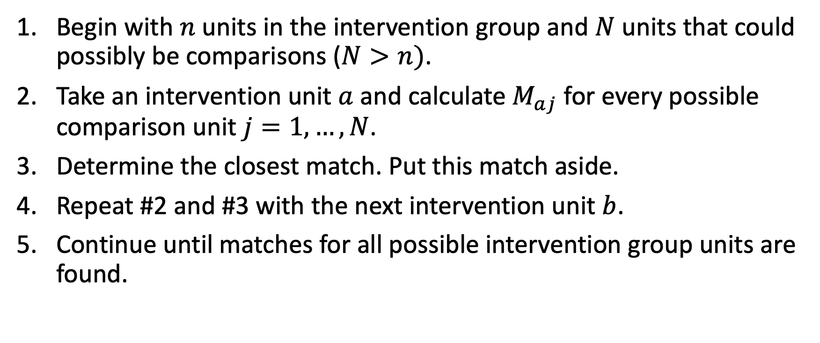
General strategy
Begin with $n$ units in the intervention group and $N$ units that could possibly be comparisons ($N>n)$.
Take an intervention unit $a$and calculate $M_{aj}$ for every possible comparison unit $j=1,…,N$.
Determine the closest match. Put this match aside.
Repeat #2 and #3 with the next intervention unit $b$.
Continue until matches for all possible intervention group units are found.

Slide 37
Variations
There are *many* variations to this approach:
You could match each intervention unit with multiple comparison units (“k to 1 matching”)
You could allow the same comparison group unit to be used as a match for multiple intervention group units (“matching with replacement”).
You could randomize the order in which you match, then do this multiple times, looking for the matching combination with the overall smallest distances (“full matching” or “genetic matching”).
These can result in better matches and improved precision, but they require more complex analytic models.

Slide 38
Pay attention to common support problems
This is a fancy way of saying that the comparison group units available for matching are *very* different than those in the intervention group.
For example, maybe our workshop includes researchers with a very high interest in research design, very high comfort with math, and many years of experience, but that the available comparison group researchers we have are much less interested, comfortable, and experienced.
We can’t match our way out of this.

Slide 39
Evaluating matching success
Remember, at the end of the process, the goal is for the intervention and comparison groups to have similar average covariate values.
We need to verify this.

Slide 40
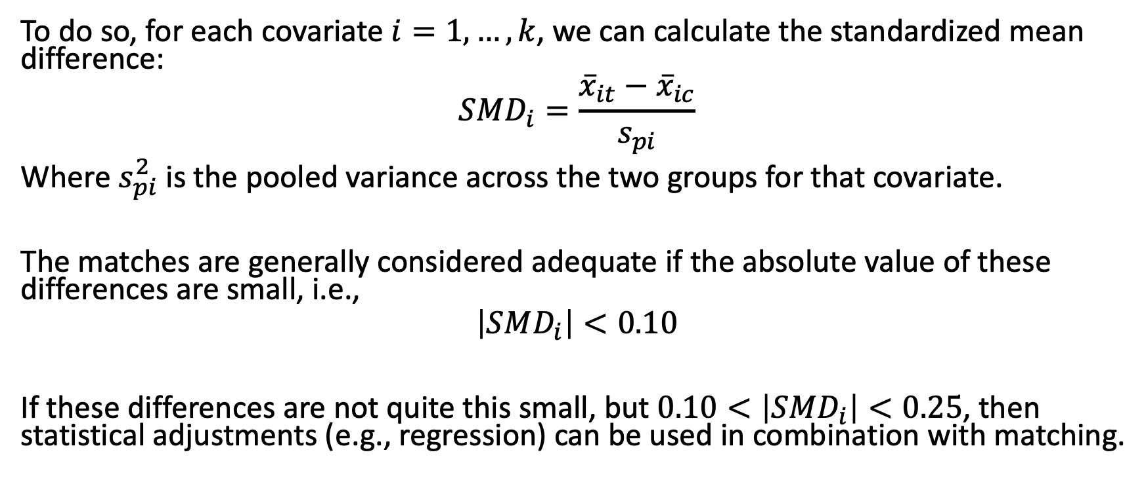
Adequacy of matches
To do so, for each covariate $i=1,…,k$, we can calculate the standardized mean difference:
$$SMD_{i}=\frac{{\overline{x}}_{it}−{\overline{x}}_{ic}}{s_{pi}}$$
Where $s_{pi}^{2}$ is the pooled variance across the two groups for that covariate.
The matches are generally considered adequate if the absolute value of these differences are small, i.e.,
$$\left|SMD_{i}\right|<0.10$$
If these differences are not quite this small, but $0.10<\left|SMD_{i}\right|<0.25$, then statistical adjustments (e.g., regression) can be used in combination with matching.

Slide 41
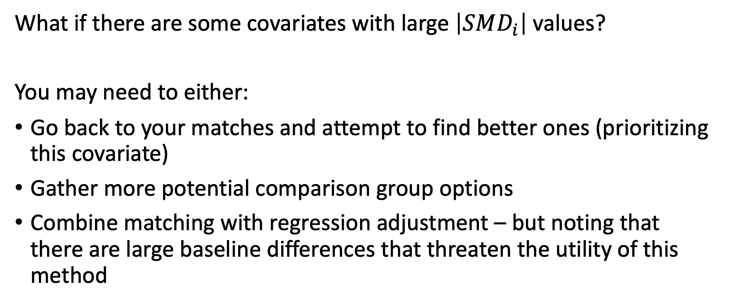
What if matches aren’t very good?
What if there are some covariates with large $\left|SMD_{i}\right|$ values?
You may need to either:
Go back to your matches and attempt to find better ones (prioritizing this covariate)
Gather more potential comparison group options
Combine matching with regression adjustment – but noting that there are large baseline differences that threaten the utility of this method

Slide 42
Statistical Adjustment Methods

Slide 43
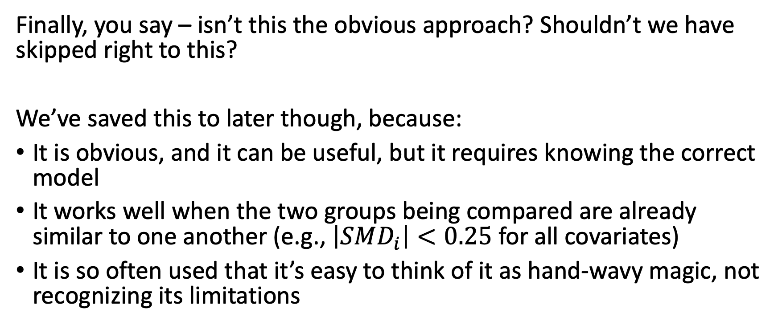
Regression and ANCOVA
Finally, you say – isn’t this the obvious approach? Shouldn’t we have skipped right to this?
We’ve saved this to later though, because:
It is obvious, and it can be useful, but it requires knowing the correct model
It works well when the two groups being compared are already similar to one another (e.g., $\left|SMD_{i}\right|<0.25$ for all covariates)
It is so often used that it’s easy to think of it as hand-wavy magic, not recognizing its limitations

Slide 44
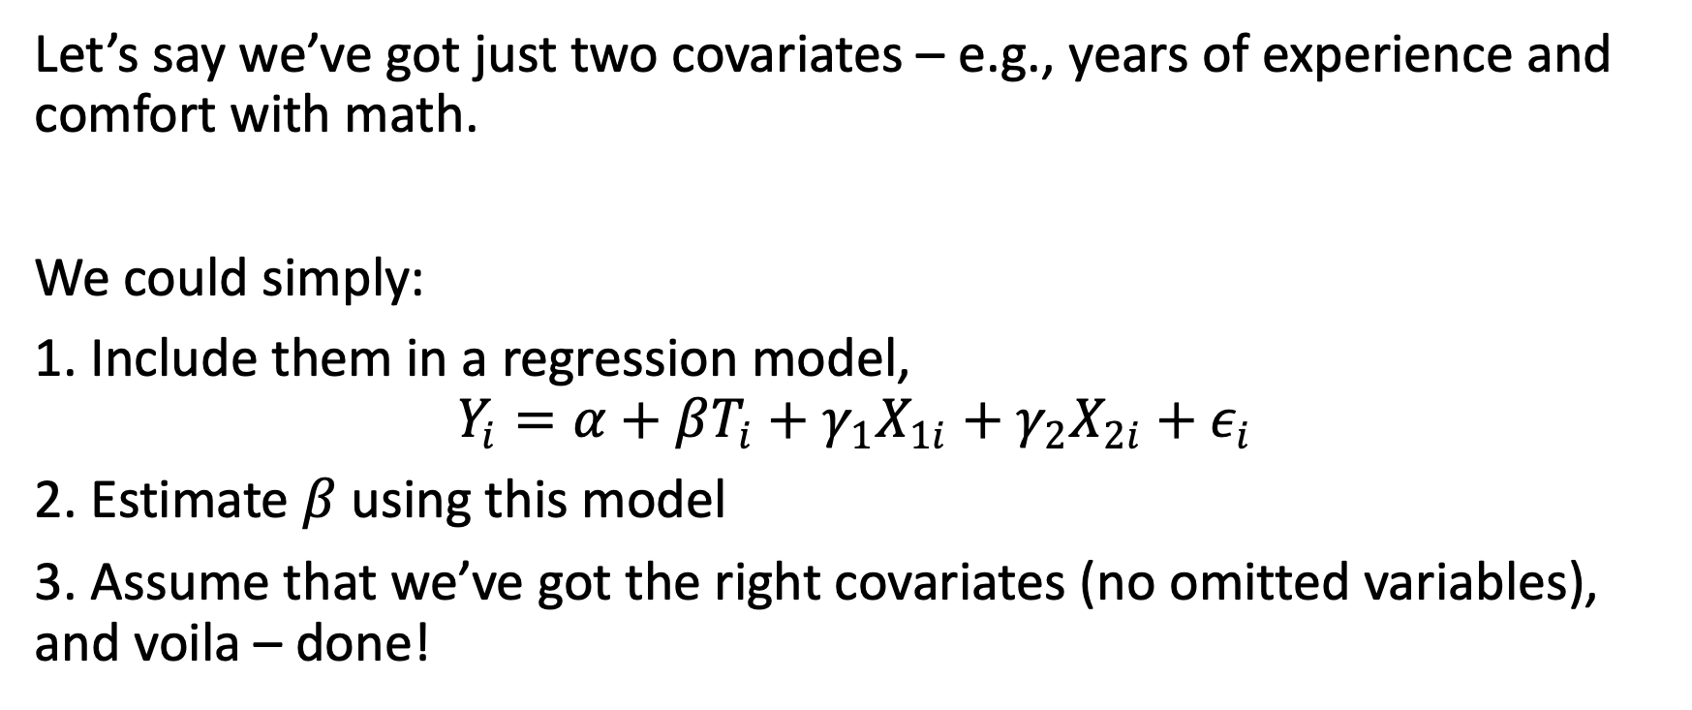
A simple model
Let’s say we’ve got just two covariates – e.g., years of experience and comfort with math.
We could simply:
1. Include them in a regression model,
$$Y_{i}=α+βT_{i}+γ_{1}X_{1i}+γ_{2}X_{2i}+ε_{i}$$
2. Estimate $β$ using this model
3. Assume that we’ve got the right covariates (no omitted variables), and voila – done!

Slide 45
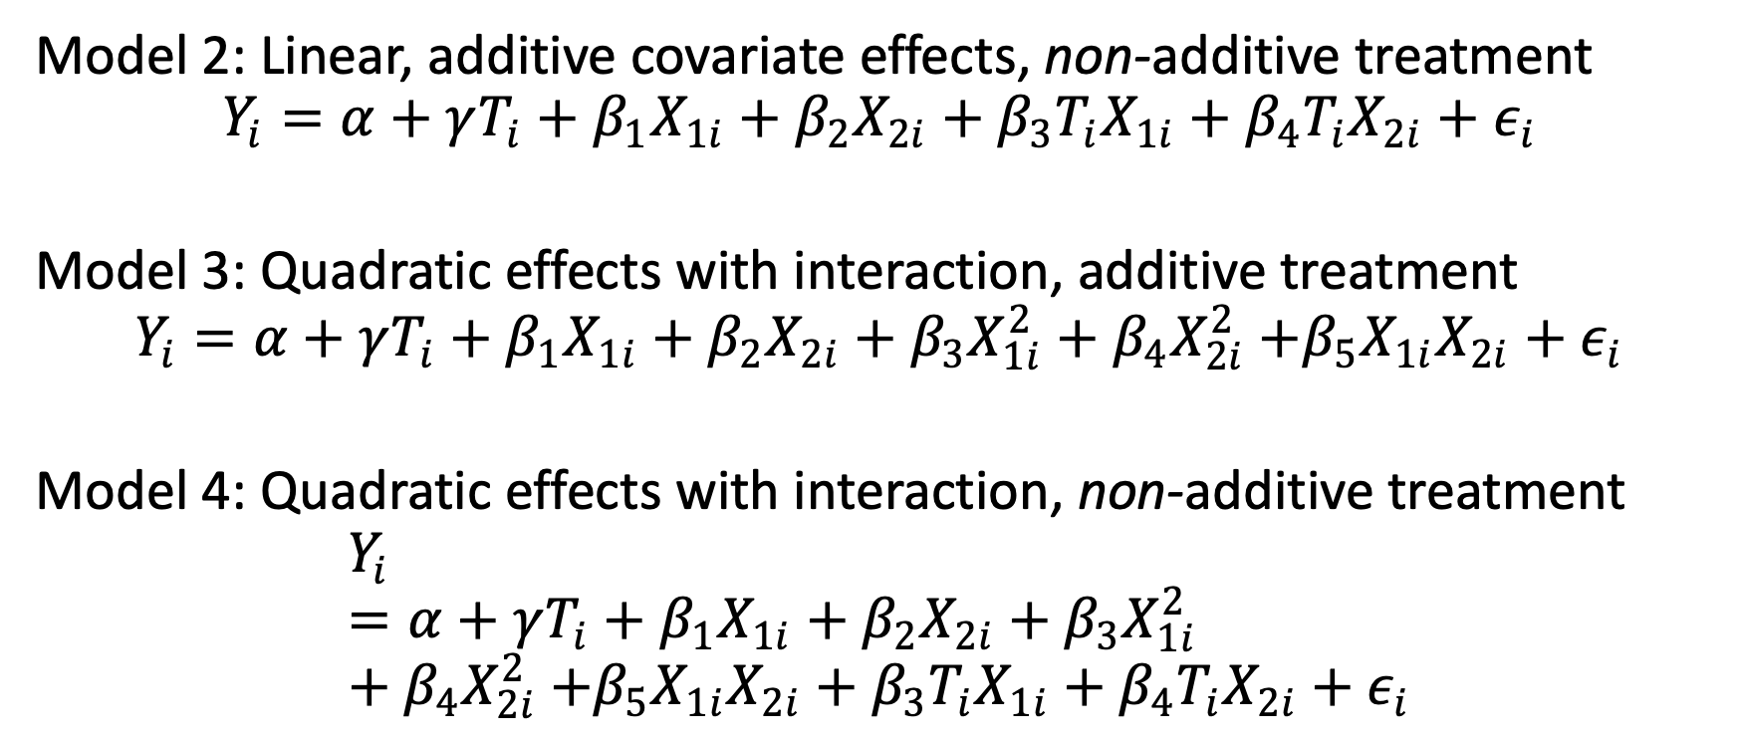
But there are many other possible models
Model 2: Linear, additive covariate effects, non-additive treatment
$$Y_{i}=α+γT_{i}+β_{1}X_{1i}+β_{2}X_{2i}+β_{3}T_{i}X_{1i}+β_{4}T_{i}X_{2i}{+ ε}_{i}$$
Model 3: Quadratic effects with interaction, additive treatment
$$Y_{i}=α+γT_{i}+β_{1}X_{1i}+β_{2}X_{2i}+β_{3}X_{1i}^{2}+β_{4}X_{2i}^{2}{+β_{5}X_{1i}X_{2i}+ε}_{i}$$
Model 4: Quadratic effects with interaction, non-additive treatment
$$Y_{i}=α+γT_{i}+β_{1}X_{1i}+β_{2}X_{2i}+β_{3}X_{1i}^{2}+β_{4}X_{2i}^{2}{+β_{5}X_{1i}X_{2i}+β_{3}T_{i}X_{1i}+β_{4}T_{i}X_{2i}+ε}_{i}$$

Slide 46
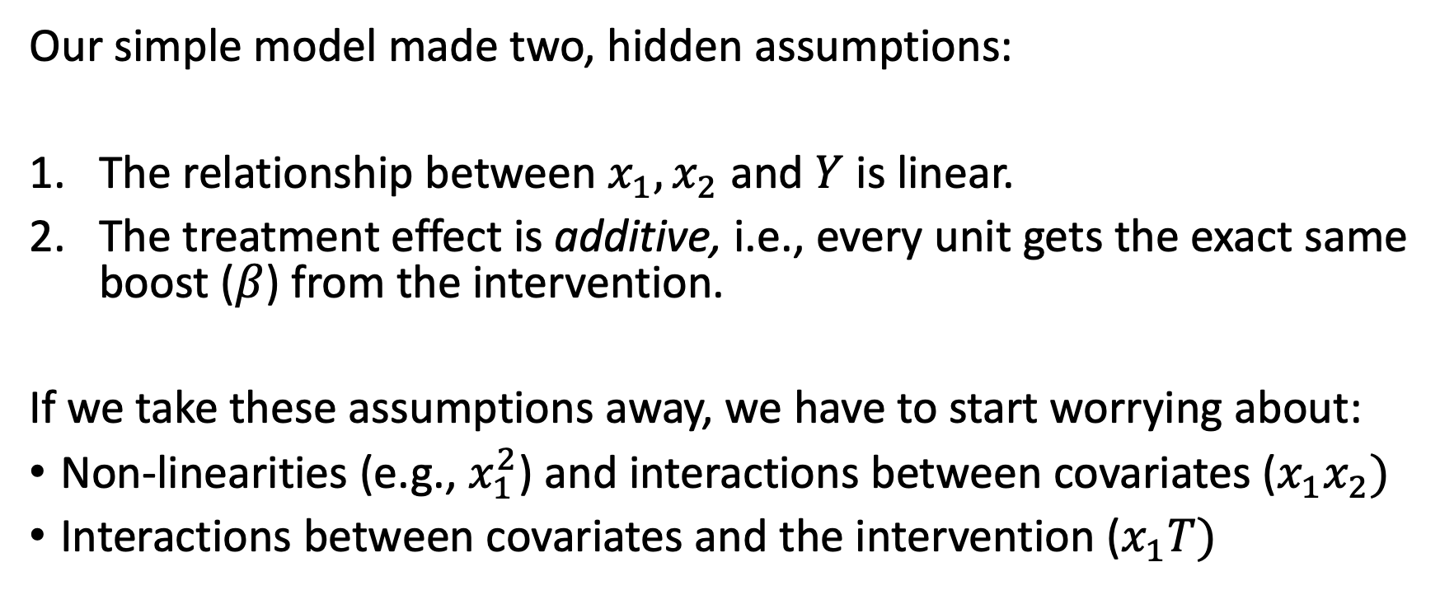
What’s going on here?
Our simple model made two, hidden assumptions:
The relationship between $x_{1},x_{2}$ and $Y$ is linear.
The treatment effect is additive, i.e., every unit gets the exact same boost ($β$) from the intervention.
If we take these assumptions away, we have to start worrying about:
Non-linearities (e.g., $x_{1}^{2}$) and interactions between covariates ($x_{1}x_{2})$
Interactions between covariates and the intervention ($x_{1}T)$

Slide 47
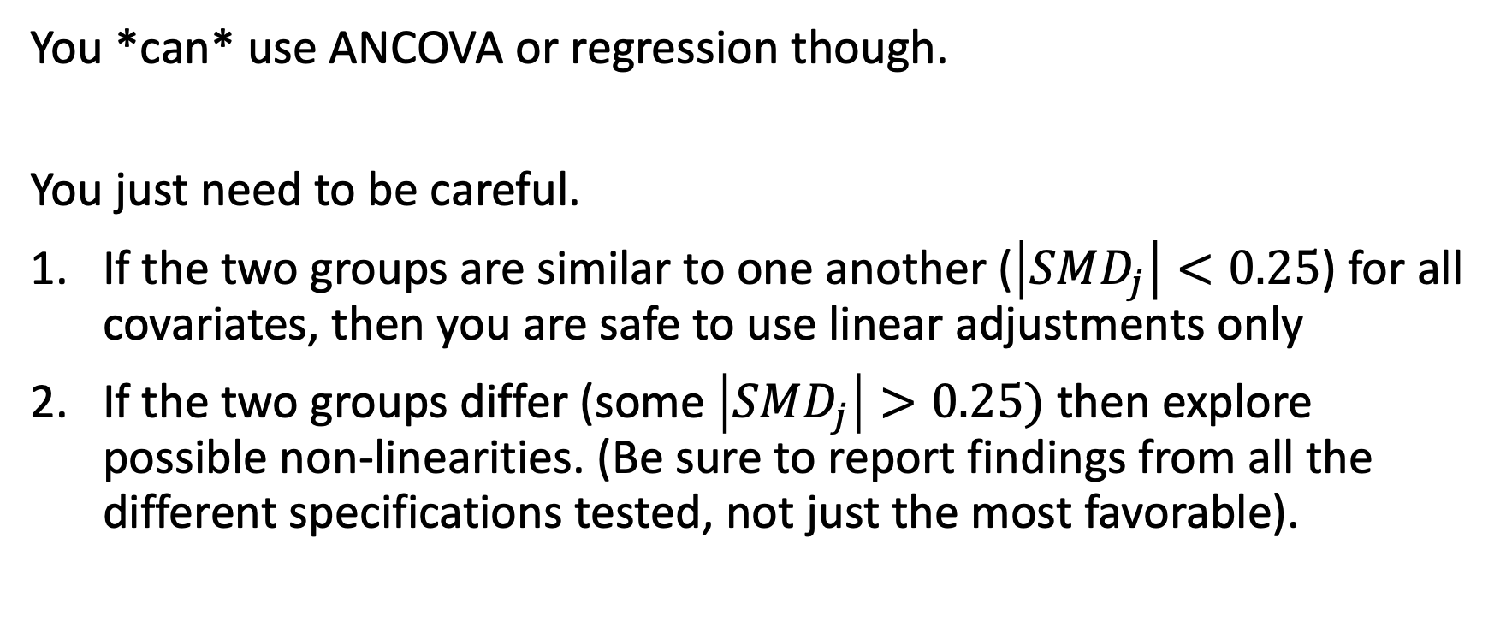
It’s not impossible though
You *can* use ANCOVA or regression though.
You just need to be careful.
If the two groups are similar to one another ($\left|SMD_{j}\right|<0.25$) for all covariates, then you are safe to use linear adjustments only
If the two groups differ (some $\left|SMD_{j}\right|>0.25)$ then explore possible non-linearities. (Be sure to report findings from all the different specifications tested, not just the most favorable).

Slide 48
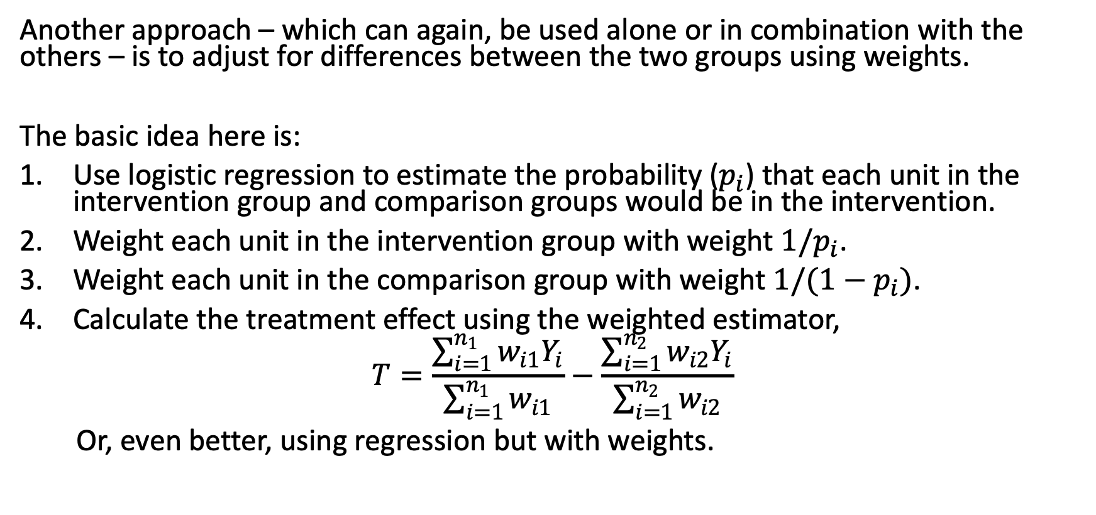
Weighting
Another approach – which can again, be used alone or in combination with the others – is to adjust for differences between the two groups using weights.
The basic idea here is:
Use logistic regression to estimate the probability ($p_{i}$) that each unit in the intervention group and comparison groups would be in the intervention.
Weight each unit in the intervention group with weight $1/p_{i}$.
Weight each unit in the comparison group with weight $1/(1−p_{i})$.
Calculate the treatment effect using the weighted estimator,
$$T=\frac{\sum_{i=1}^{n_{1}}{w_{i1}Y_{i}}}{\sum_{i=1}^{n_{1}}{w_{i1}}}−\frac{\sum_{i=1}^{n_{2}}{w_{i2}Y_{i}}}{\sum_{i=1}^{n_{2}}{w_{i2}}}$$
Or, even better, using regression but with weights.

Slide 49
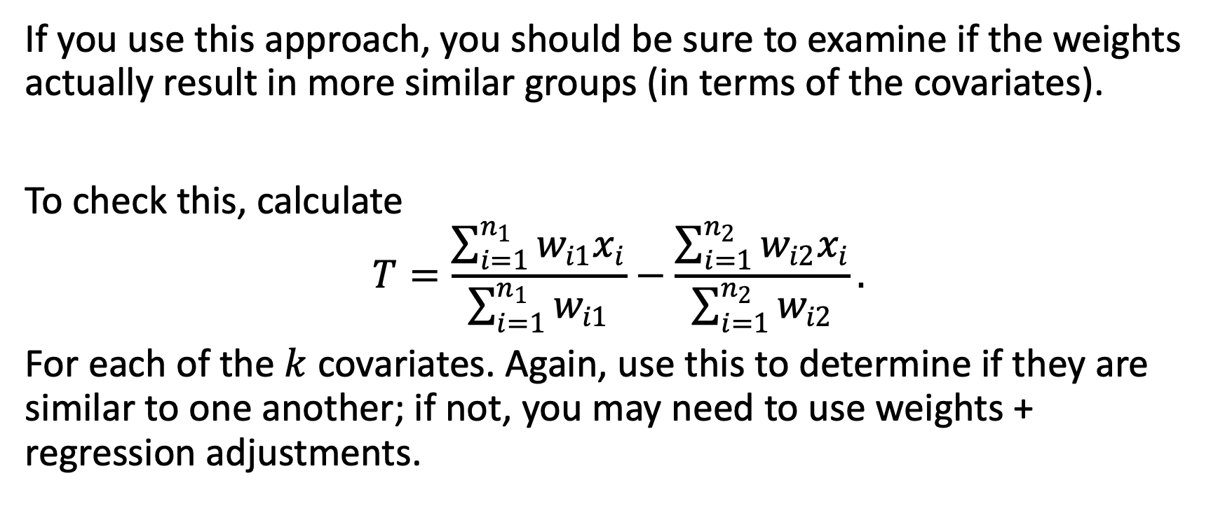
This is complicated, too
If you use this approach, you should be sure to examine if the weights actually result in more similar groups (in terms of the covariates).
To check this, calculate
$$T=\frac{\sum_{i=1}^{n_{1}}{w_{i1}x_{i}}}{\sum_{i=1}^{n_{1}}{w_{i1}}}−\frac{\sum_{i=1}^{n_{2}}{w_{i2}x_{i}}}{\sum_{i=1}^{n_{2}}{w_{i2}}}.$$
For each of the $k$ covariates. Again, use this to determine if they are similar to one another; if not, you may need to use weights + regression adjustments.

Slide 50
Reporting Guidelines

Slide 51
ATOM
The American Statistical Association recommends the following to guide reporting:
Accept uncertainty, be Thoughtful, Open, and Modest.
Accepting uncertainty means planning studies that are sensitive (e.g., a large enough sample to detect a reasonable MDES).
Being thoughtful means carefully evaluating your results: How precise is the estimate? Is the model correctly specified? Are the assumptions reasonable and understood? Do the results hold if I change my model?

Slide 52
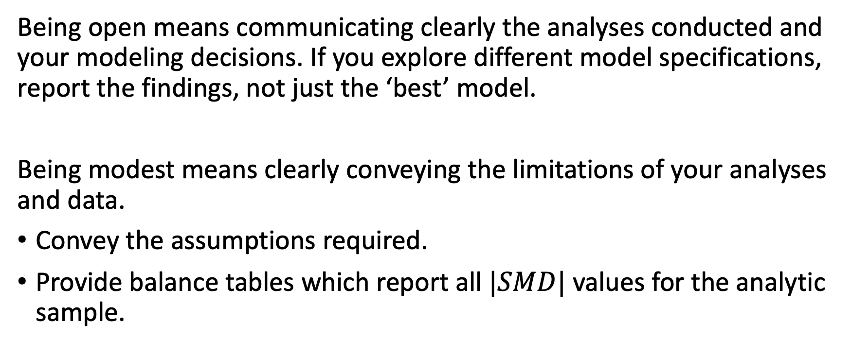
ATOM
Being open means communicating clearly the analyses conducted and your modeling decisions. If you explore different model specifications, report the findings, not just the ‘best’ model.
Being modest means clearly conveying the limitations of your analyses and data.
Convey the assumptions required.
Provide balance tables which report all $|SMD|$ values for the analytic sample.

Slide 53
Example balance table

